Slide 1






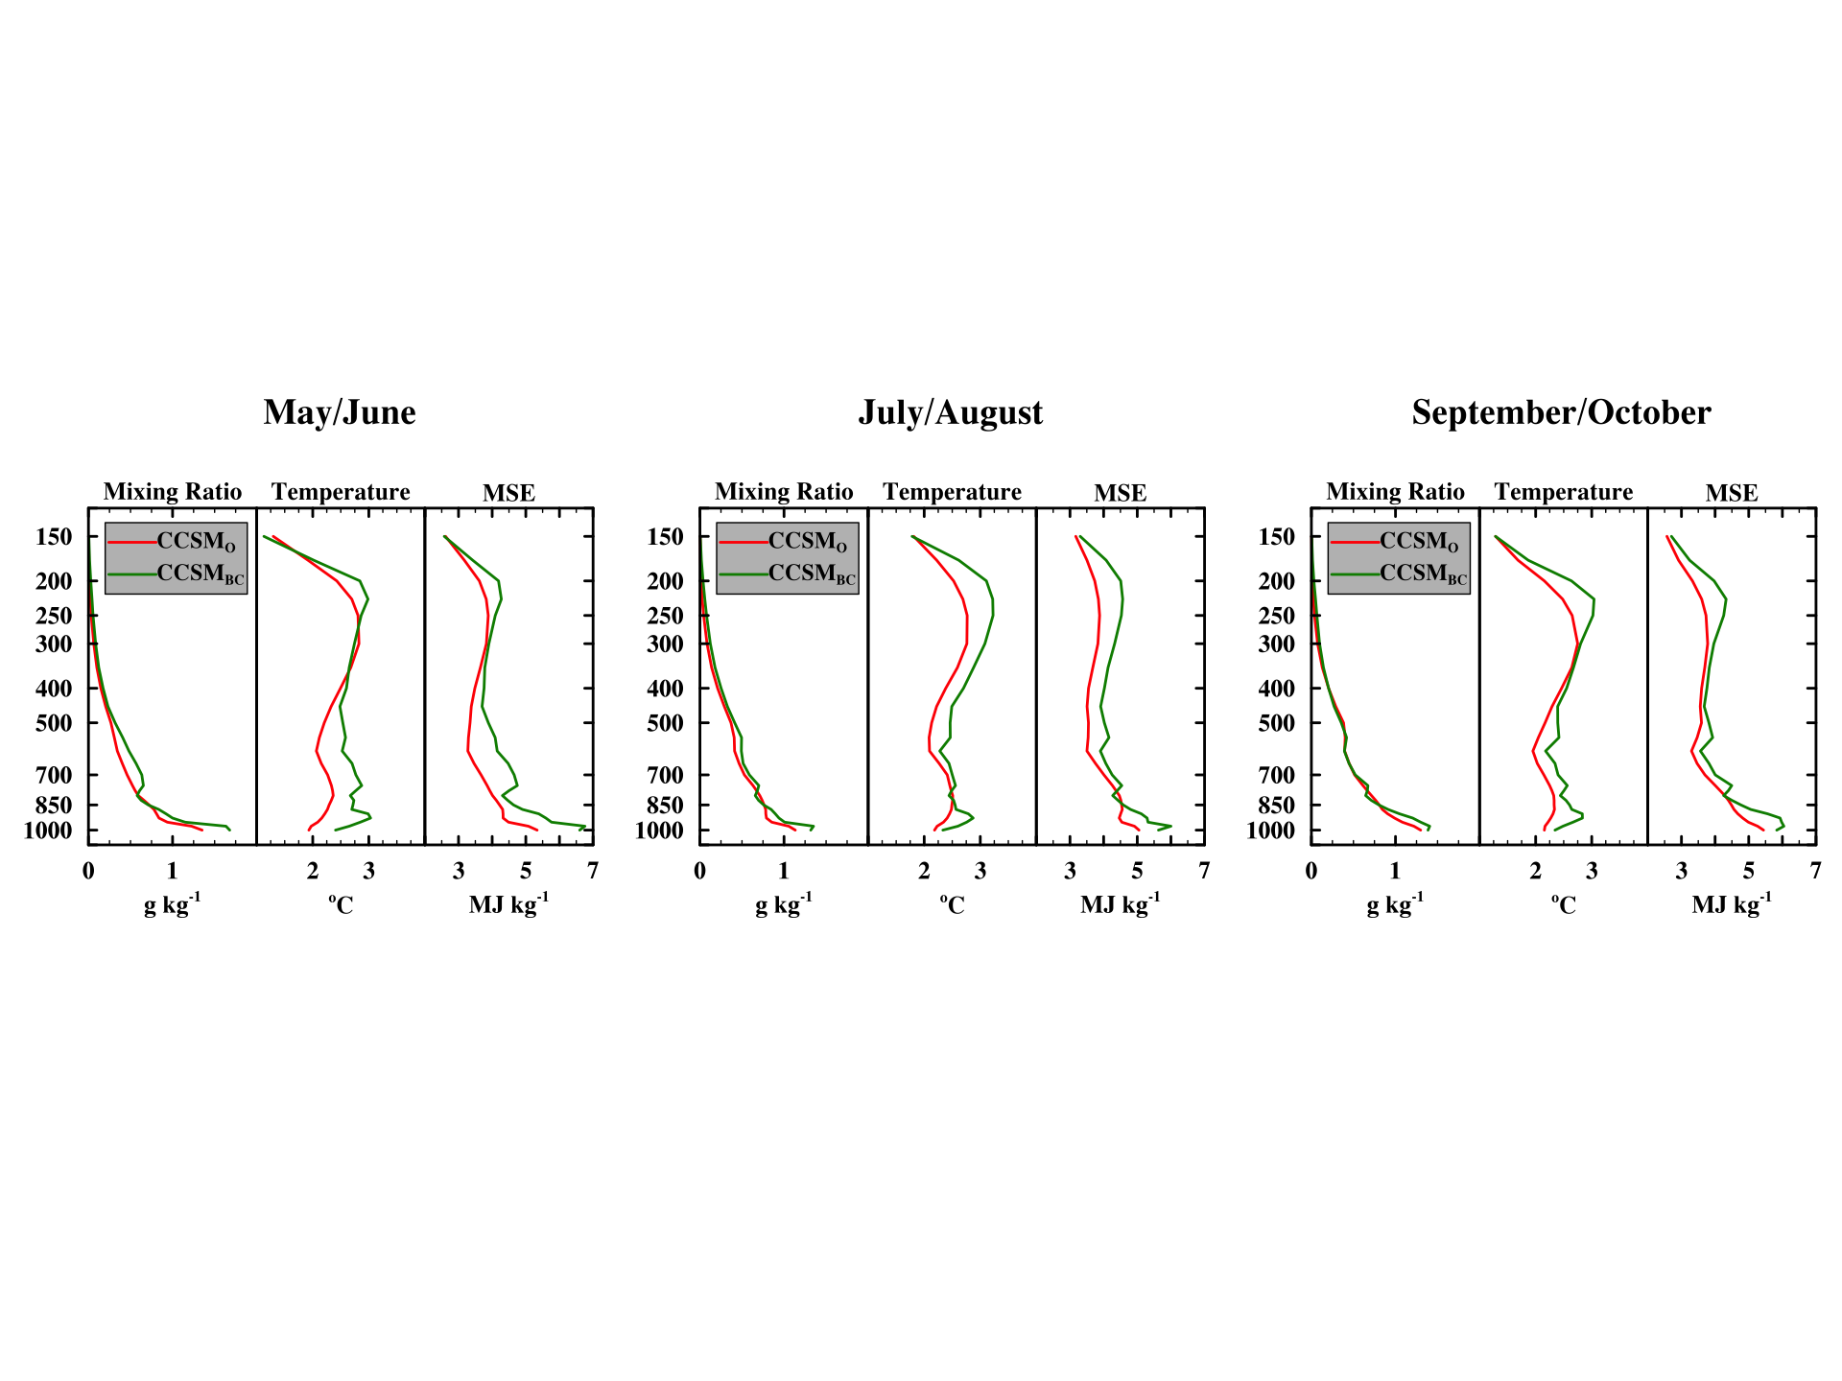
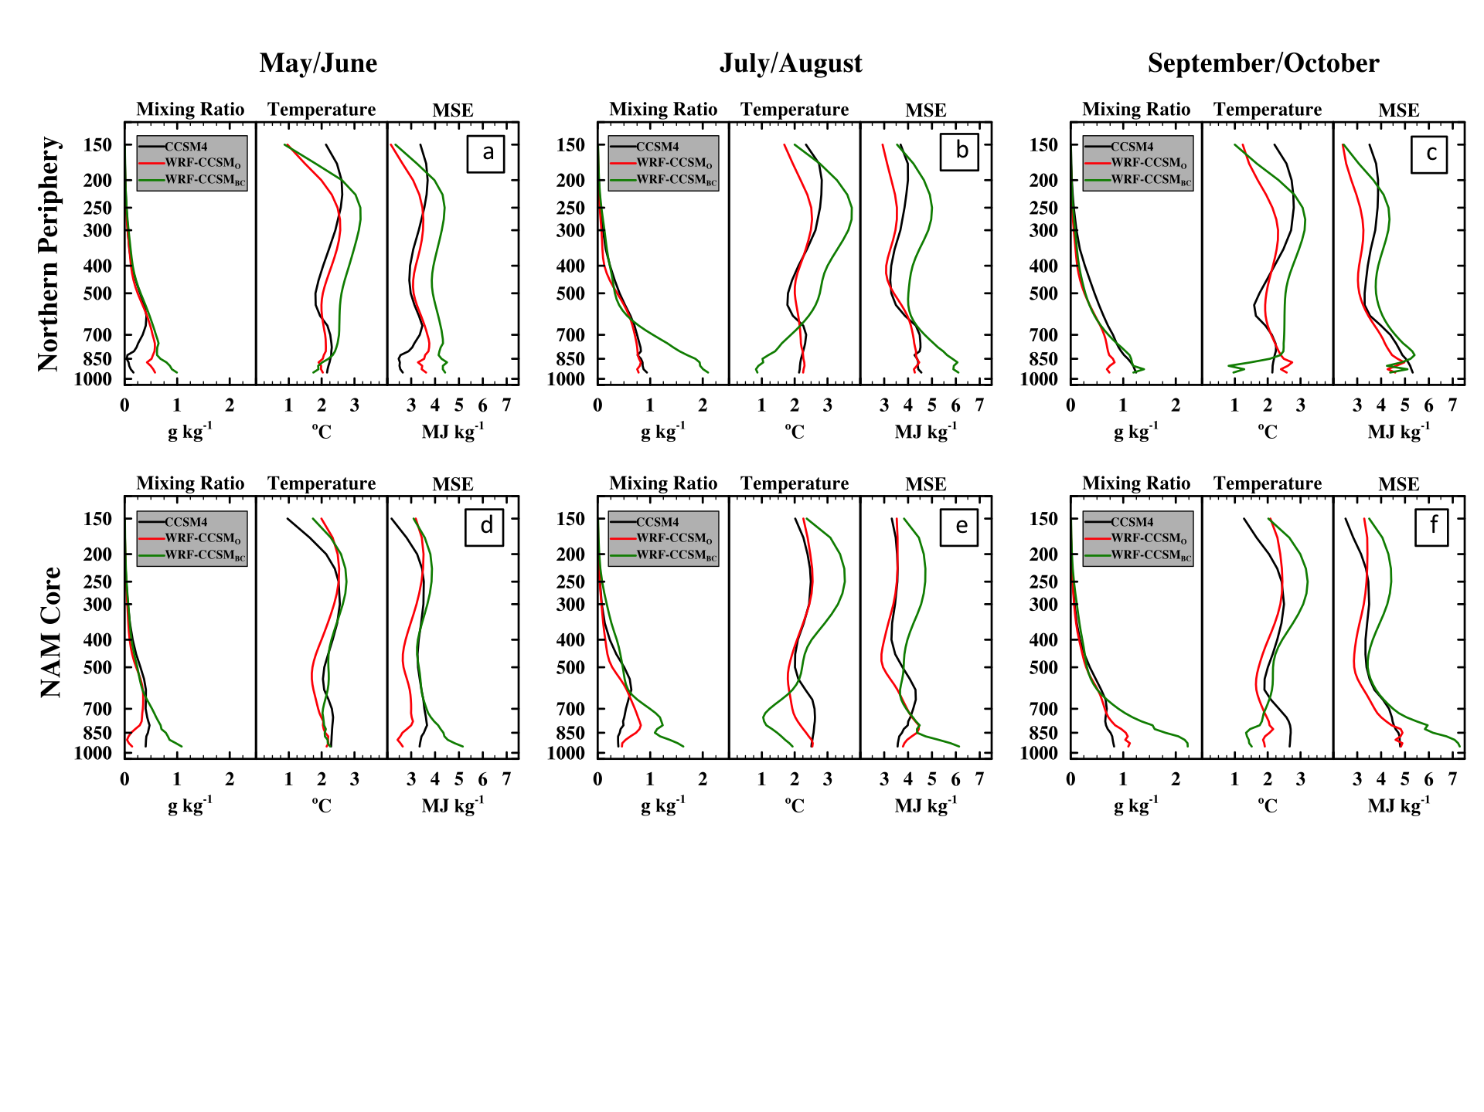
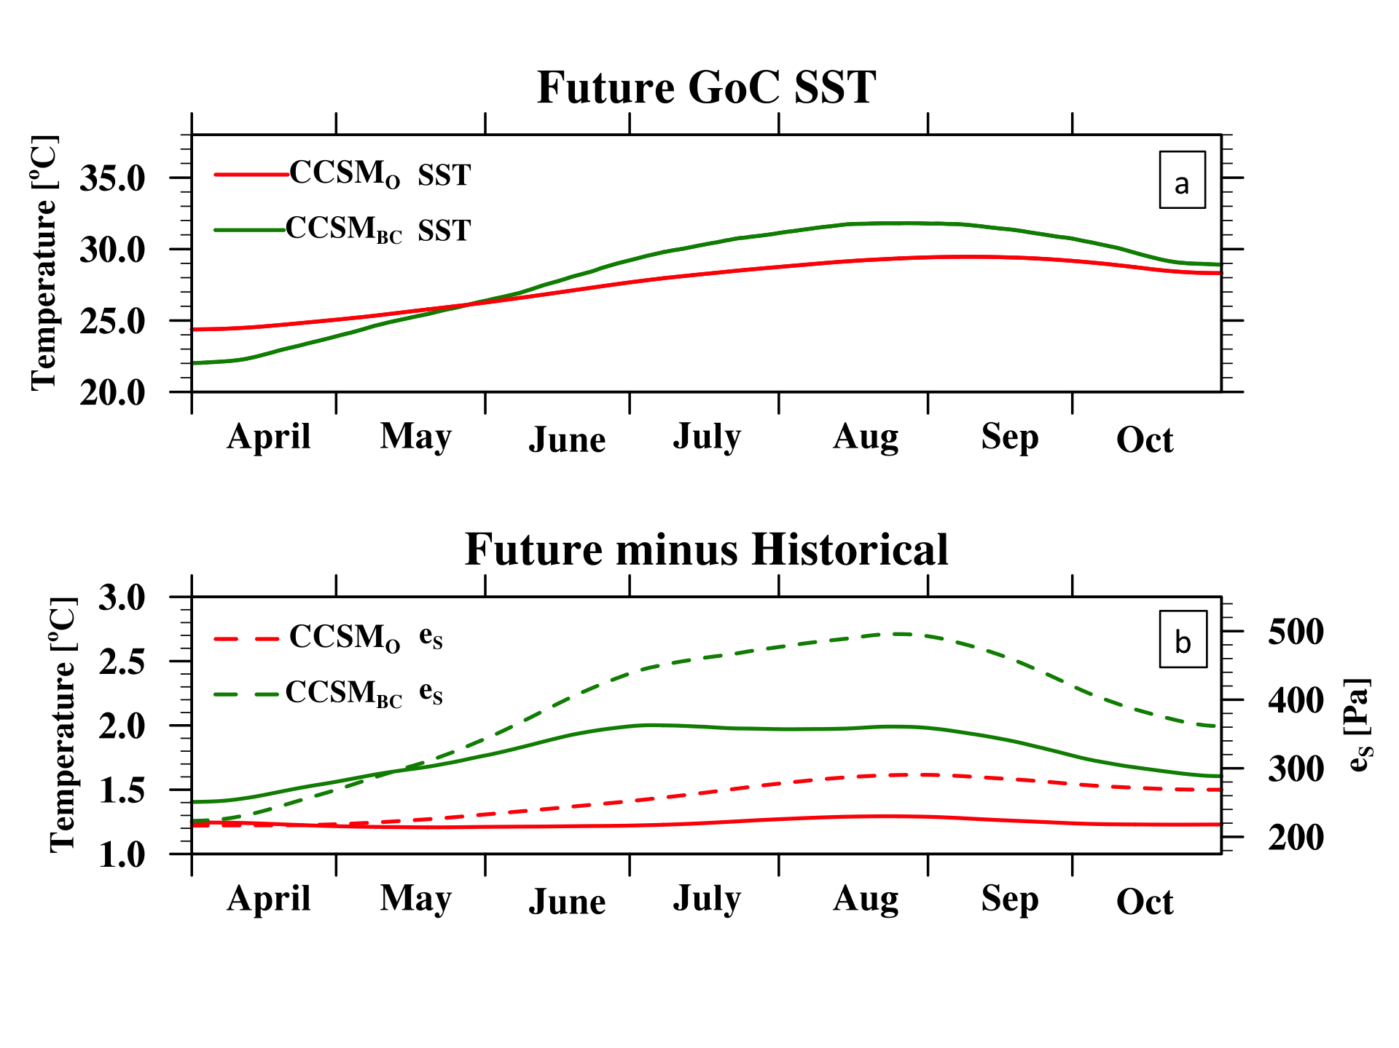
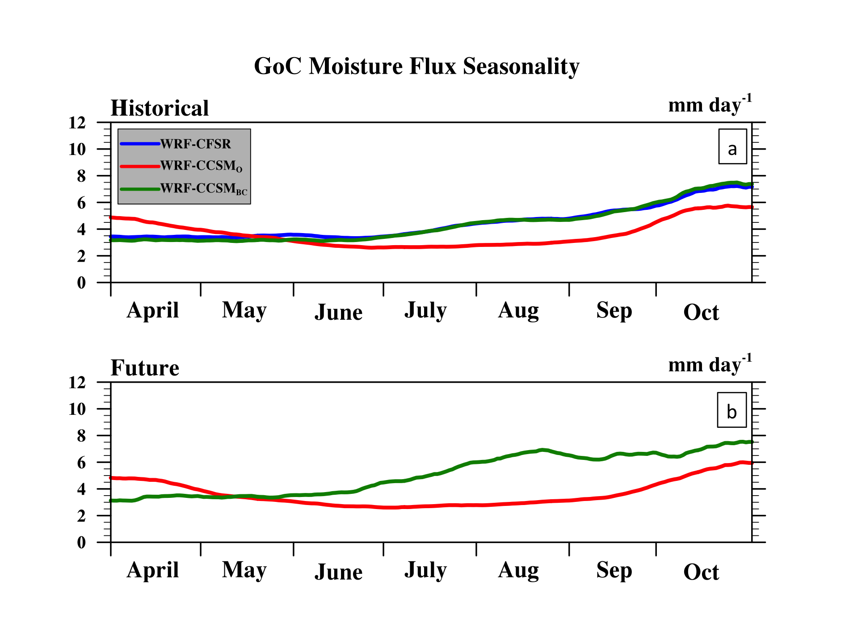
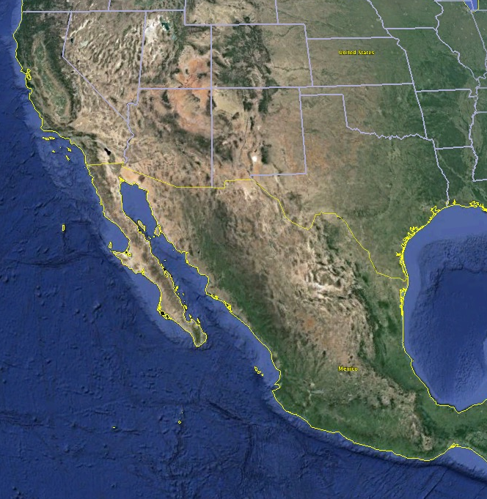
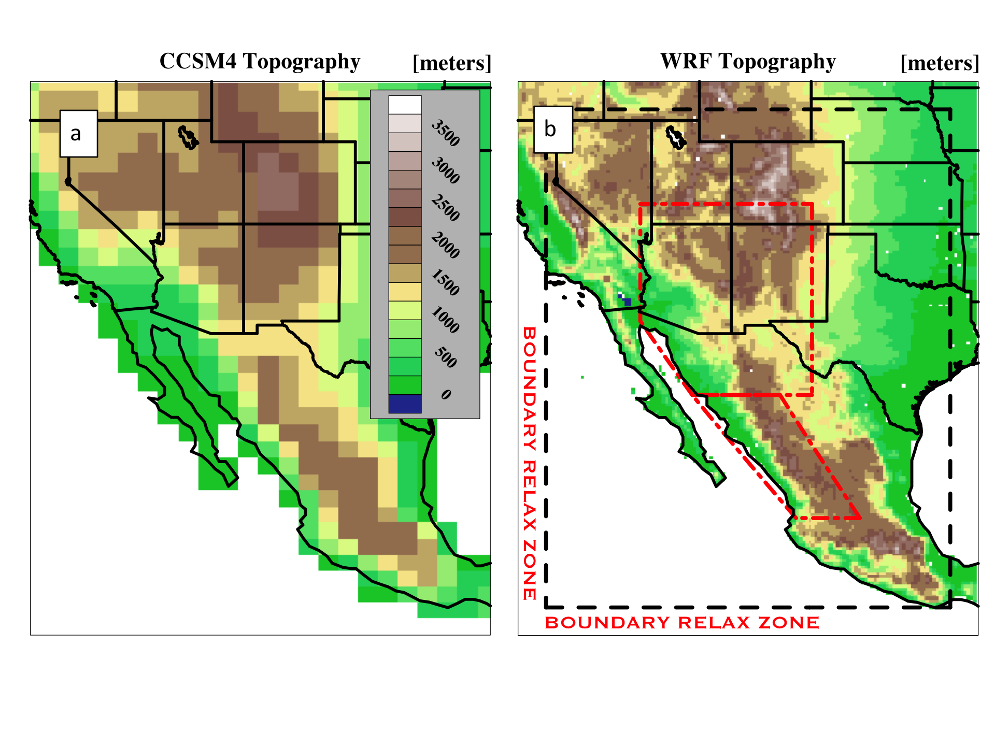

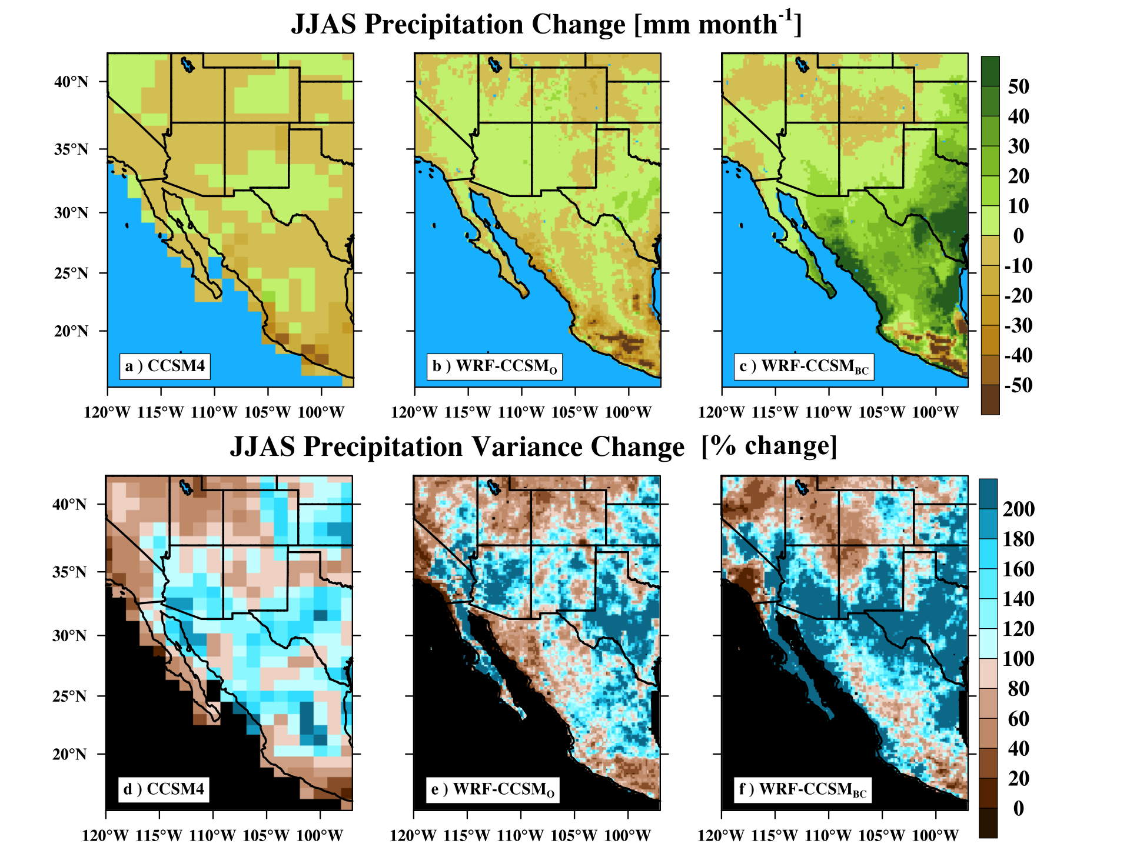
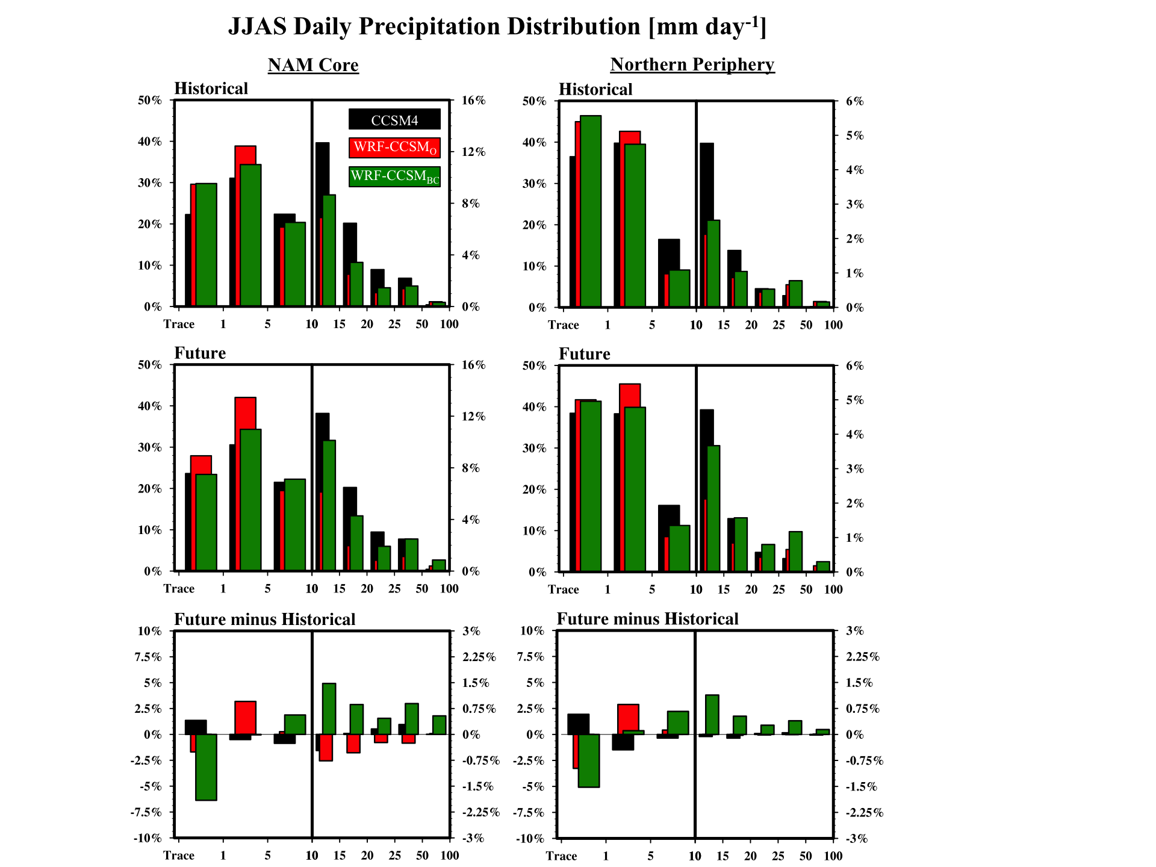
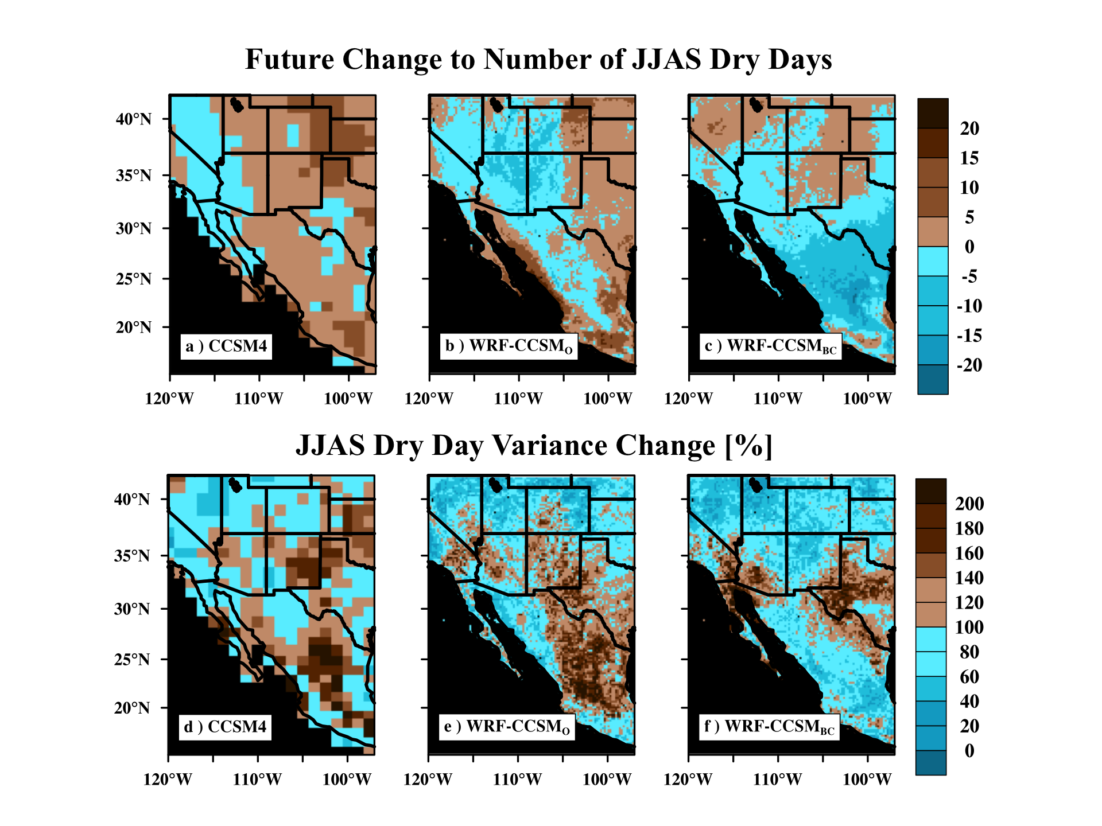
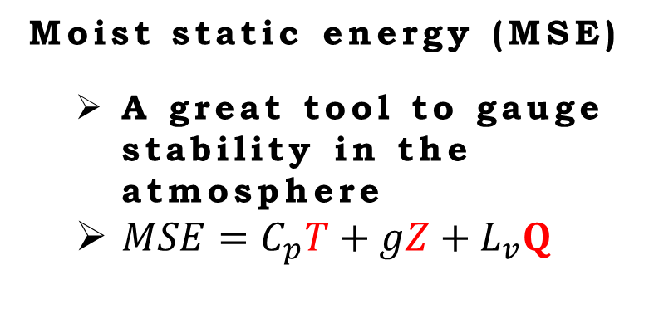
Global Warming, Climate Modeling, and the Response
of the North American Monsoon Convective Environment
to Land Surface Forcing
2016
Jonathan D.D. Meyer: Department of Plants Soils and Climate, Utah State University (jonathan.meyer@aggiemail.usu.edu)
Jiming Jin: Department of Plants Soils and Climate & Department of Watershed Sciences, Utah State University
Intro. and Background
The North American Monsoons (NAM) can provide upwards of 70% of the annual precipitation to the southwest United States and Mexico. Already susceptible to prolonged drought conditions, the expected doubling of the region’s population by the middle of the century has created a highly uncertain state of future water resources across this region.
Future projections of the NAM using coarse-resolution general circulation models (GCM) has suggested that the NAM onset will shift later in the season, with a slight increase in the intensity of the mature phase. Overall, current GCMs suggest a general drying trend across the region. Under a global warming scenario, mid- and upper-level tropospheric temperatures warm, resulting in a more stable atmosphere (Cook and Seager 2013; Seth et al. 2015). The more stable atmosphere is responsible for the delayed onset, as the atmosphere requires extra energy in the form of low-level moisture convergence to overcome the additional tropospheric stability.
Unfortunately, the inability of GCMs to accurately resolve the finer-scale climate processes and their interaction with the larger synoptic scale results in substantial uncertainty for the future state of the NAM. Many of the poorly resolved components of the NAM are associated with the relationship between the regional topography and the Gulf of California (GoC) which is a primary moisture source for the NAM. Observational studies have shown the GoC plays a role in the onset and intensity of NAM rainfall (Mitchell et al. 2002). Here, using a higher resolution Regional Climate Model (RCM), we test the ability of better resolved land-atmosphere interactions to influence the convective environment of the NAM domain.
Future changes to land surface forcing
Global models suggest increasing tropospheric temperatures will suppress global monsoon systems. But how well do they capture the other component of atmospheric stability…near-surface moisture???
Boundary Forcing
Comparison
Internal Model Comparison
Moist static energy (MSE)
A great tool to gauge stability in the atmosphere
$MSE=C_{p}T+gZ+L_{v}Q$
Increases to MSE result in greater atmospheric stability
Temperature Driven
Increases to MSE result in greater atmospheric INstability
Moisture driven
Where is the excess moisture coming from?
The role of accurate sea surface temperatures and the seasonal cycle of surface evaporation.
Model comparison
GoG Evaporation
To better understand the role of land surface forcing on the convective environment across the NAM domain, we compared the differences between CCSM4 (~140-km grid spacing) and a RCM with 20-km grid spacing. 32-year climatologies from a historical period (1979-2010) and end-of-the-century (2068-2099) climatology were used for comparison. The largest differences between model resolutions can be found when comparing the depiction of the Sierra Madre Occidental (SMO) mountains and the Gulf of California (GoC), which are crudely represented by CCSM; one of the higher resolution CMIP5 models). These features represent primary controlling features on the NAM environment.
Onset
Mature
Decay
Onset
Mature
Decay
Onset
Mature
Decay
Onset
Mature
Decay
GoC
SMO
Response of monsoon rainfall
CCSM4 contains a general drying trend.
Simply improving the representation reverese the trend across the southwestern U.S. and the ridgline of the SMO.
With a bias corrected RCM, the reversal is substantial across the core region.
This comparison highlights the role the GoC and better resolved topography has on the NAM trend, as well as the role water vapor has on atmospheric stability
discussion
Current phase GCM models suggest the NAM and other global monsoon systems will exhibit a general drying trend through the end of the 21st century, with a later onset but slightly increased mature-season intensity. While these models capture the increased atmospheric stability from a warming troposphere, comparison of moist static energy profiles over the core of the NAM region suggest the role of near-surface water vapor on atmospheric stability is poorly represented by coarse-resolution GCMs.
Our findings are as follows:
When simply downscaling a GCM for the NAM, the drying trend across the southwestern U.S. reverses towards a wetter monsoon with earlier onsets, and more frequent and intense daily rainfall.
Biases inherent to CCSM4’s seasonality and magnitudes of the NAM environment greatly limit the effectiveness of improved surface forcing
When performing bias correction on CCSM4 output, surface forcing from evaporation further reverses the drying trend from CCSM4 by greatly increasing the near-surface instability.
Without an accurate representation of surface forcing from moisture on the convective environment, the accuracy of the competition between convective drivers is called into question.
Changes to the future daily rainfall intensity distribution shows CCSM4 has a shift towards more light rainfall events.
Downscaled simulations suggest a shift away from light rainfall events
Bias corrected downscaled simulations—and the greater moisture and instability—shift towards more extreme rainfall events.
Change to average number of JJAS dry days
CCSM4 indicates more days WITHOUT rainfall.
Downscaling leads to a coherent pattern of more days WITH rainfall.
Increased resolution and the more unstable atmosphere due to increased surface MSE cause more raindays.
acknowledgement and references
This project was funded through the National Science Foundation Microsystem Program project NSFEF-1065730.
Mitchell D. et al. 2002: Gulf of California Sea Surface Temperatures and the North American Monsoon: Mechanistic Implications from Observations. J. Climate, 15, 2261–2281.
Seth A., et al. 2013: CMIP5 Projected Changes in the Annual Cycle of Precipitation in Monsoon Regions. J. Climate, 26, 7328–7351.
3. Cook BI, Seager R (2013) The response of the North American monsoon to increased
greenhouse gas forcing. Journal of Geophysical Research: Atmospheres, 118(4), 1690-1699
CCSM4
WRF-CCSM_{O}
WRF-CCSM_{BC}

